Slide 1
Sailing Directions
From paper to web -
Greenland Harbour Pilot

Slide 2
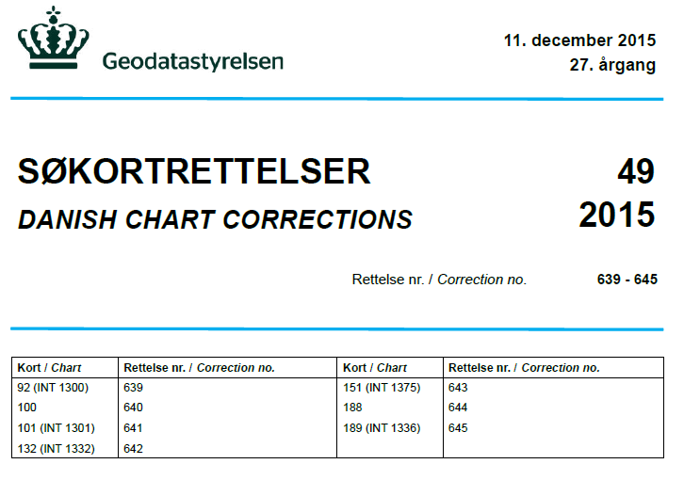
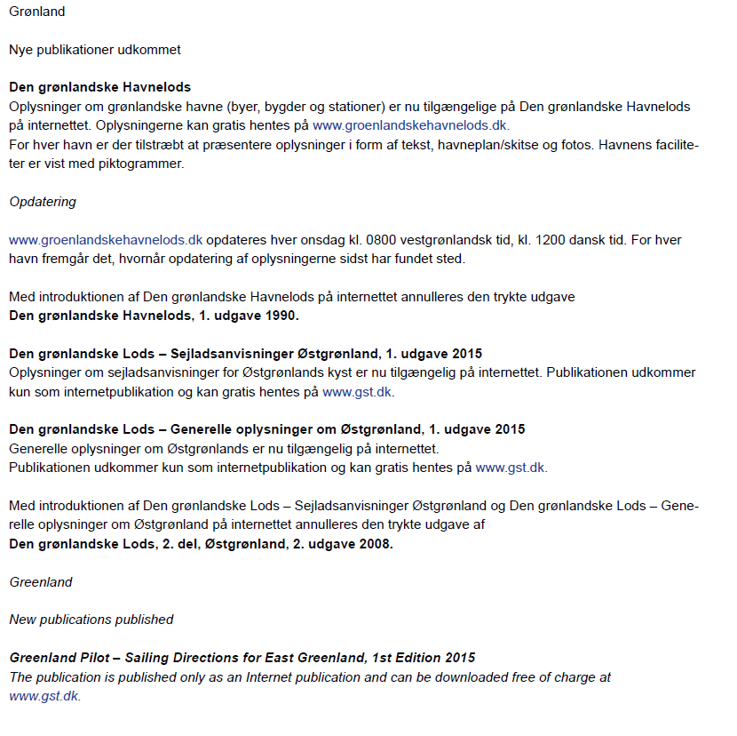
In December 2015 The Danish Hydrographic Office published 3 pilots as internet publications only and the paper version was withdrawn.
“Den grønlandske Havnelods”
”Den grønlandske Lods – Sejladsanvisninger Østgrønland”
“Den grønlandske Lods – Generelle oplysninger om Østgrønland”
And the first English version.
“Greenland Pilot – Sailing Directions for East Greenland”

Slide 3

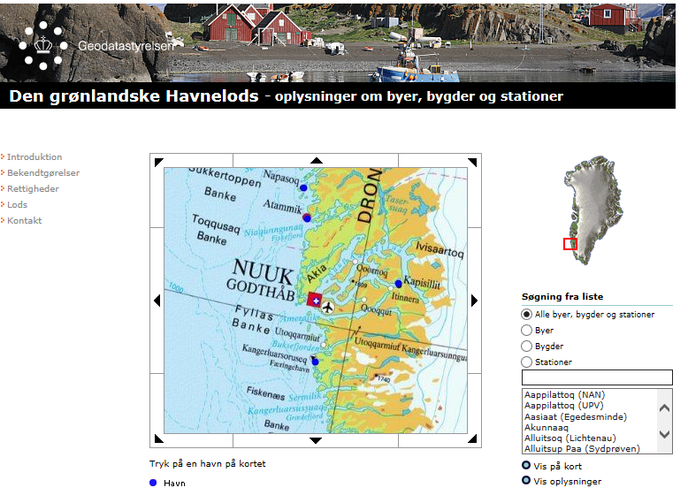
Greenland Harbour Pilot From printed publication to web

Slide 4
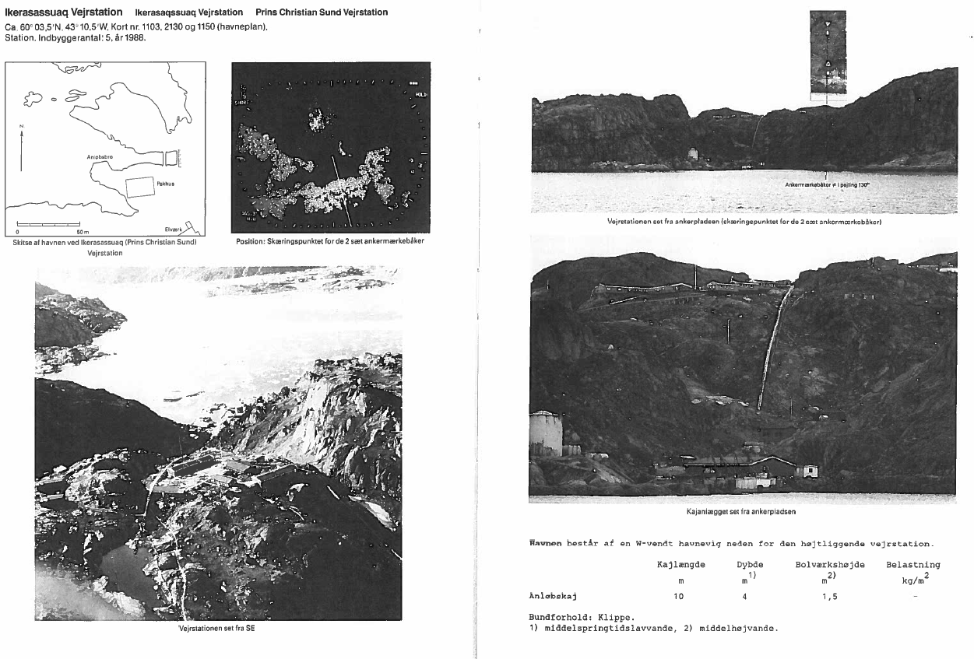
Greenland Harbour Pilot Data available in printed publication (Ikerassuaq Vejrstation)

Slide 5
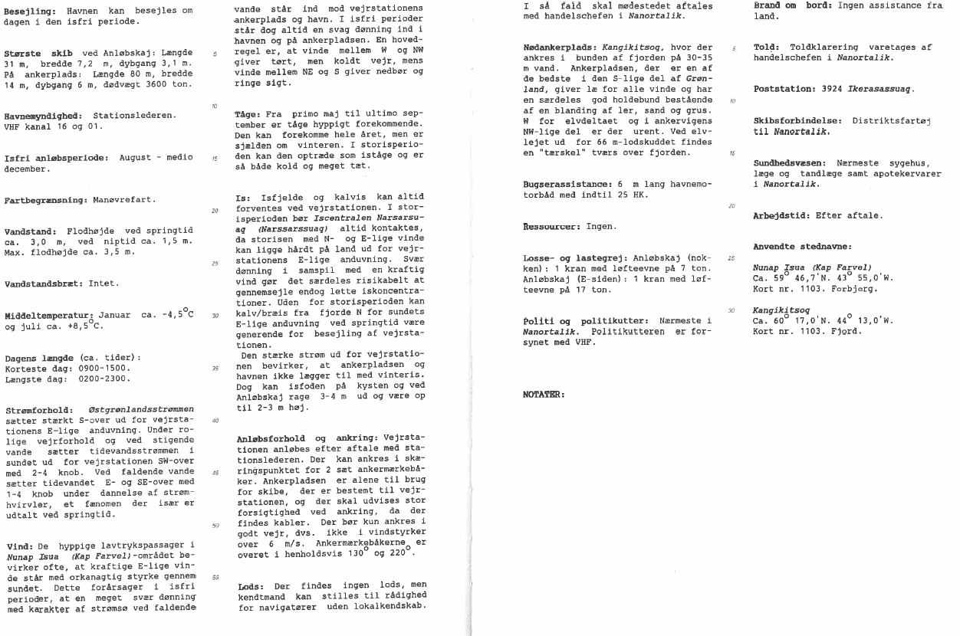
Greenland Harbour Pilot Data available in printed publication (Ikerassuaq Vejrstation)

Slide 6
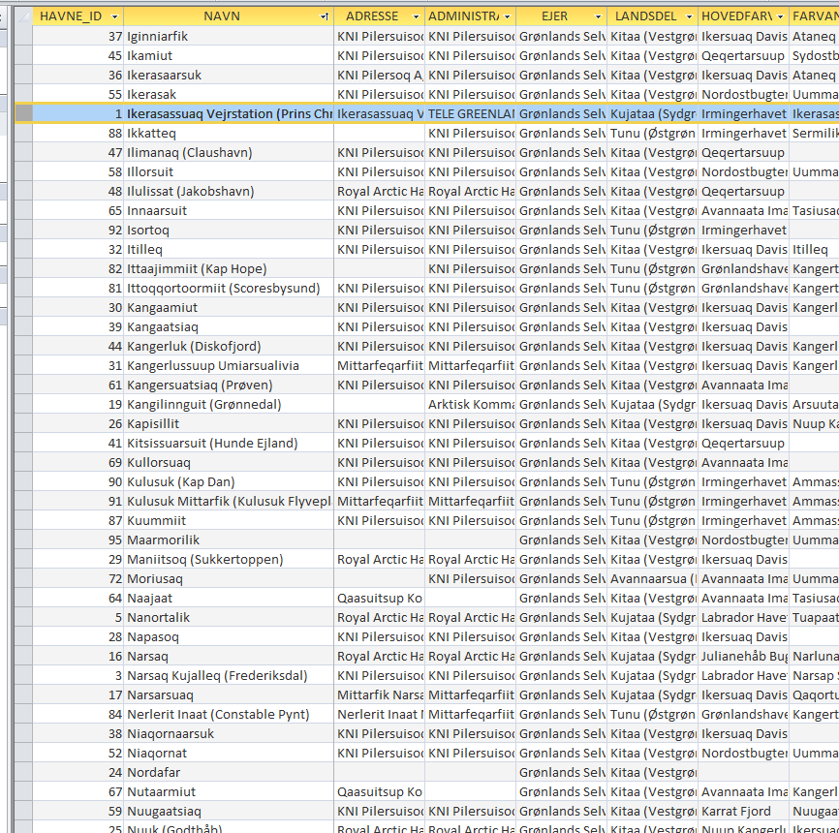
Data from 96 harbours and settlements was entered manually.
A large amount of outdated data should be updated.
Due to poor infrastructure in Greenland alternative fact finding was necessary.

Slide 7
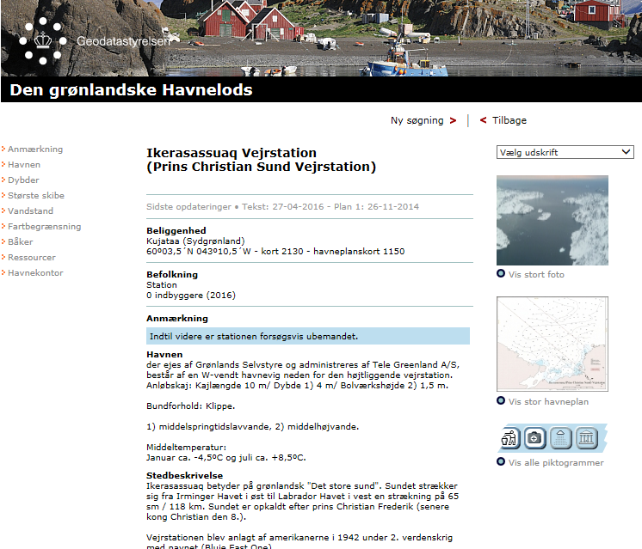
Greenland Harbour Pilot Information available on web (Ikerassuaq Vejrstation)
http://www.gronlandskehavnelods.dk

Slide 8
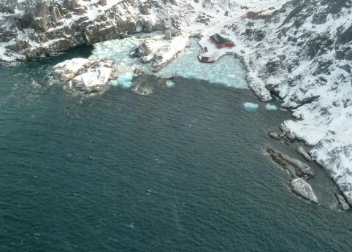
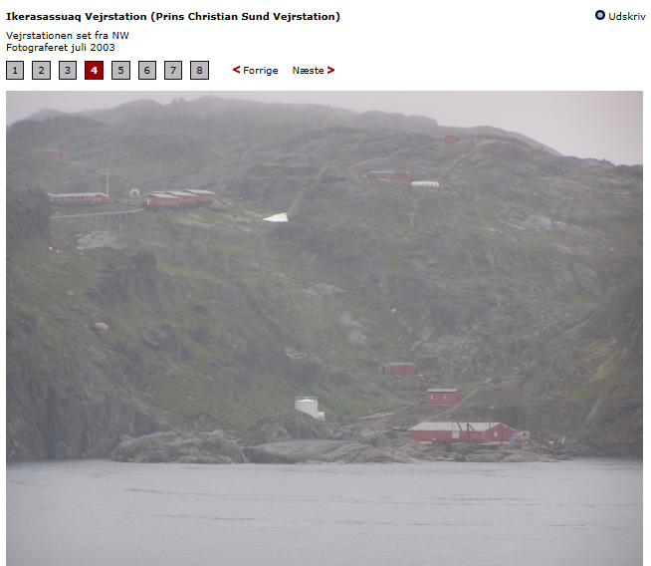
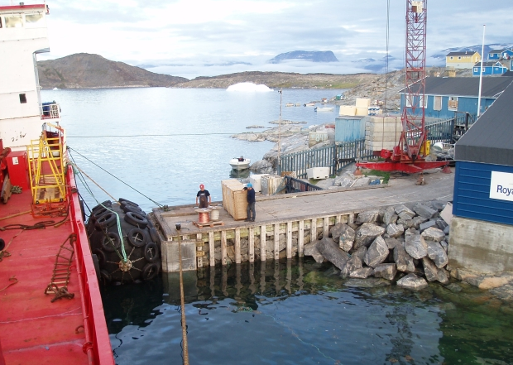
Greenland Harbour Pilot
Information available on web
456 photos from
Captains
Shipping Companies
Icepatrol
All photos customized manually.

Slide 9
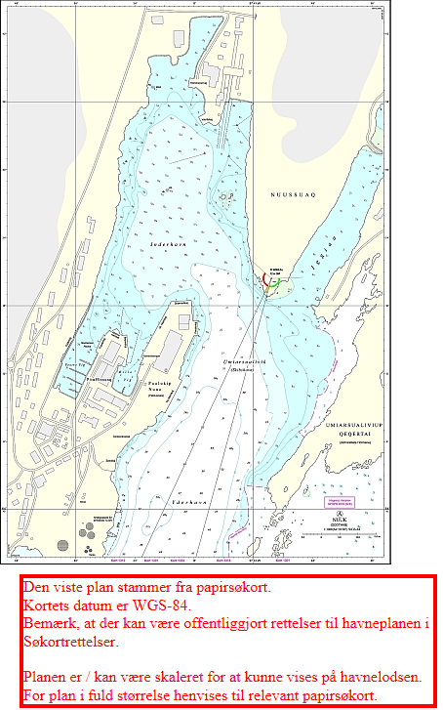
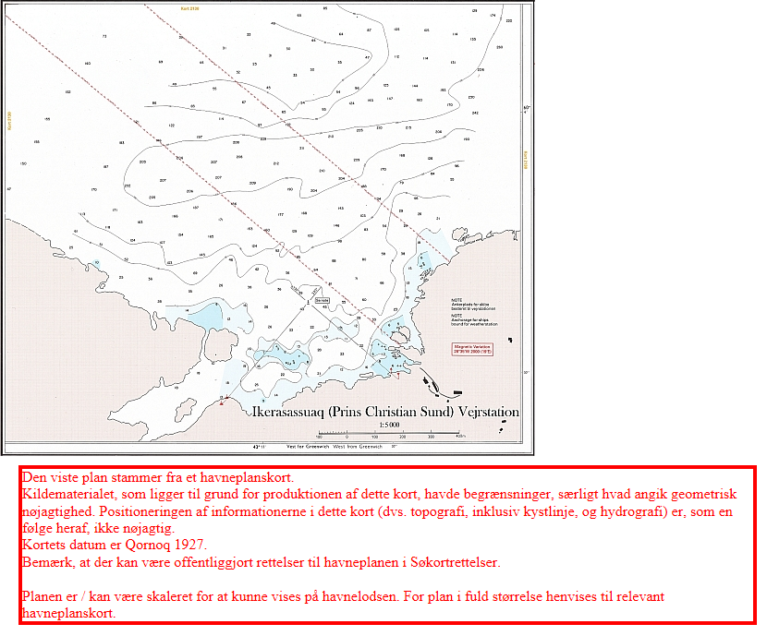
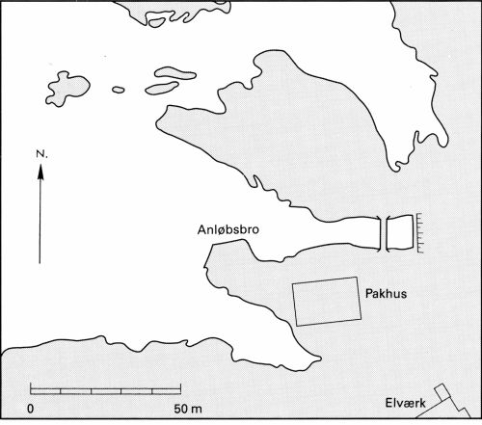
Greenland Harbour Pilot
Information available on web
166 plans
Different quality
All plans customized manually in 3 different formats.
Need for new type of notes

Slide 10
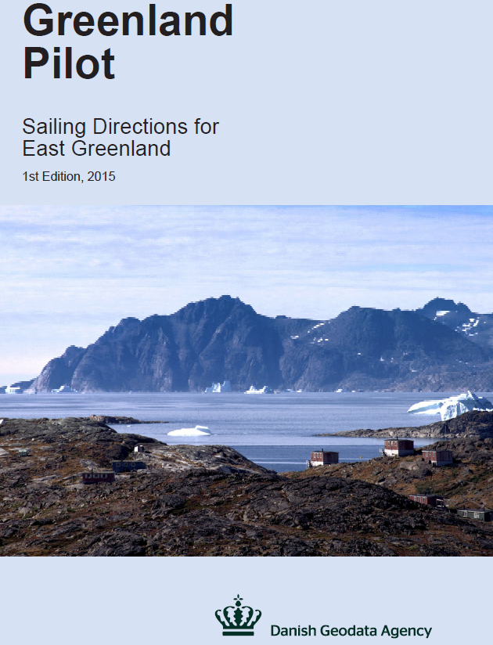
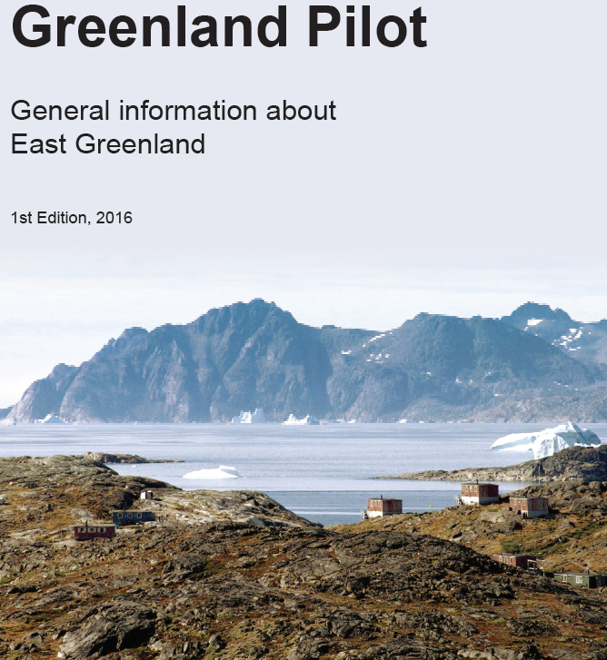
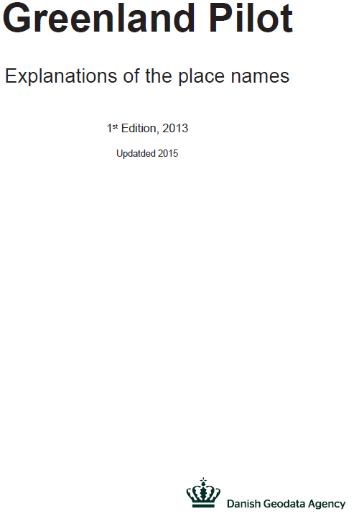
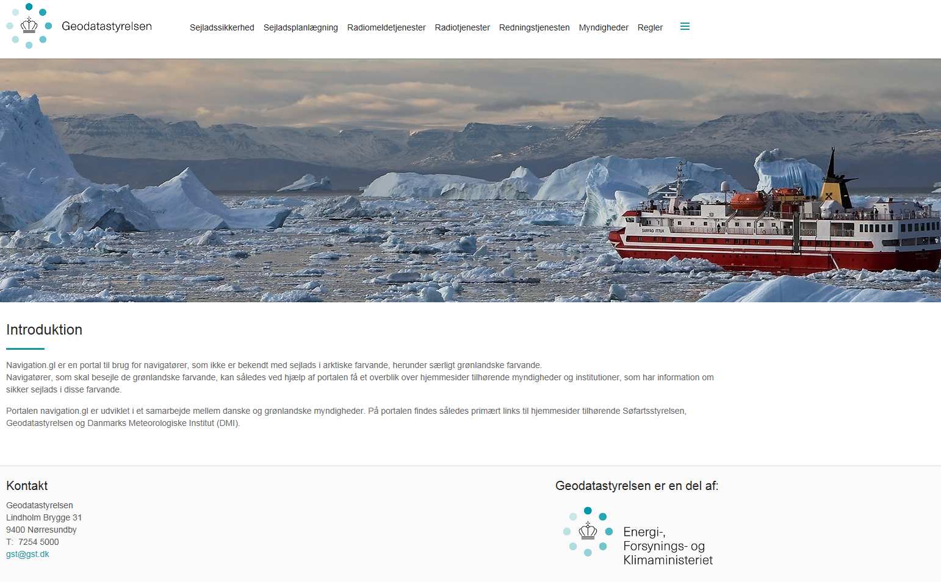
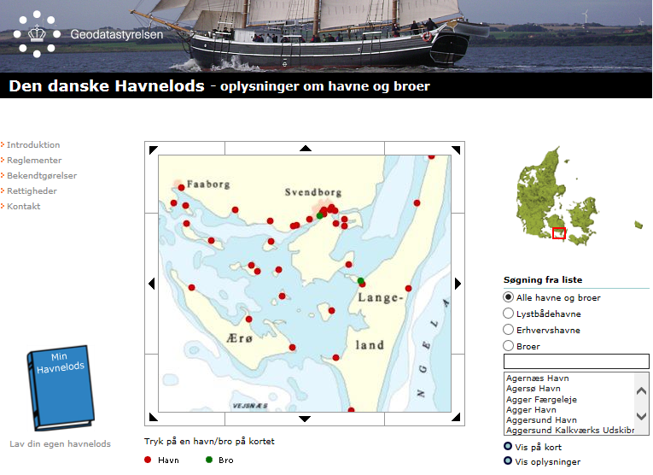
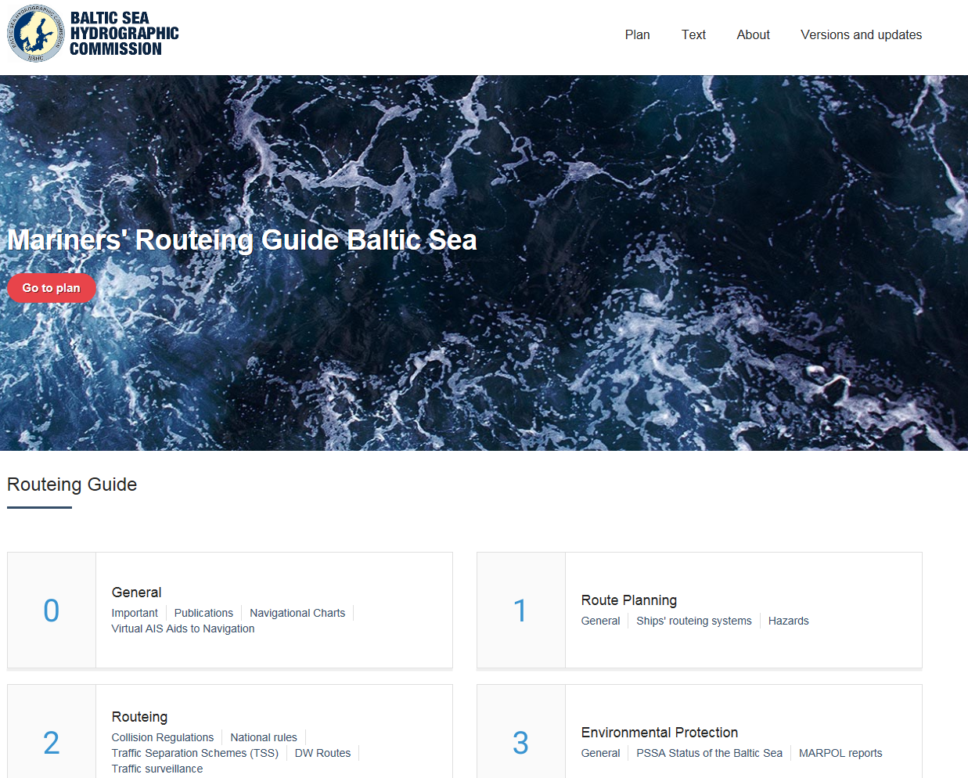
Web publication
can be downloaded free of charge
Sailing Directions for East Greenland
General information about East Greenland
Explanations of the place names
Web information
Den danske Havnelods
Den grønlandske Havnelods
Navigation.gl
Mariners' Routeing Guide Baltic Sea

